Slide 1
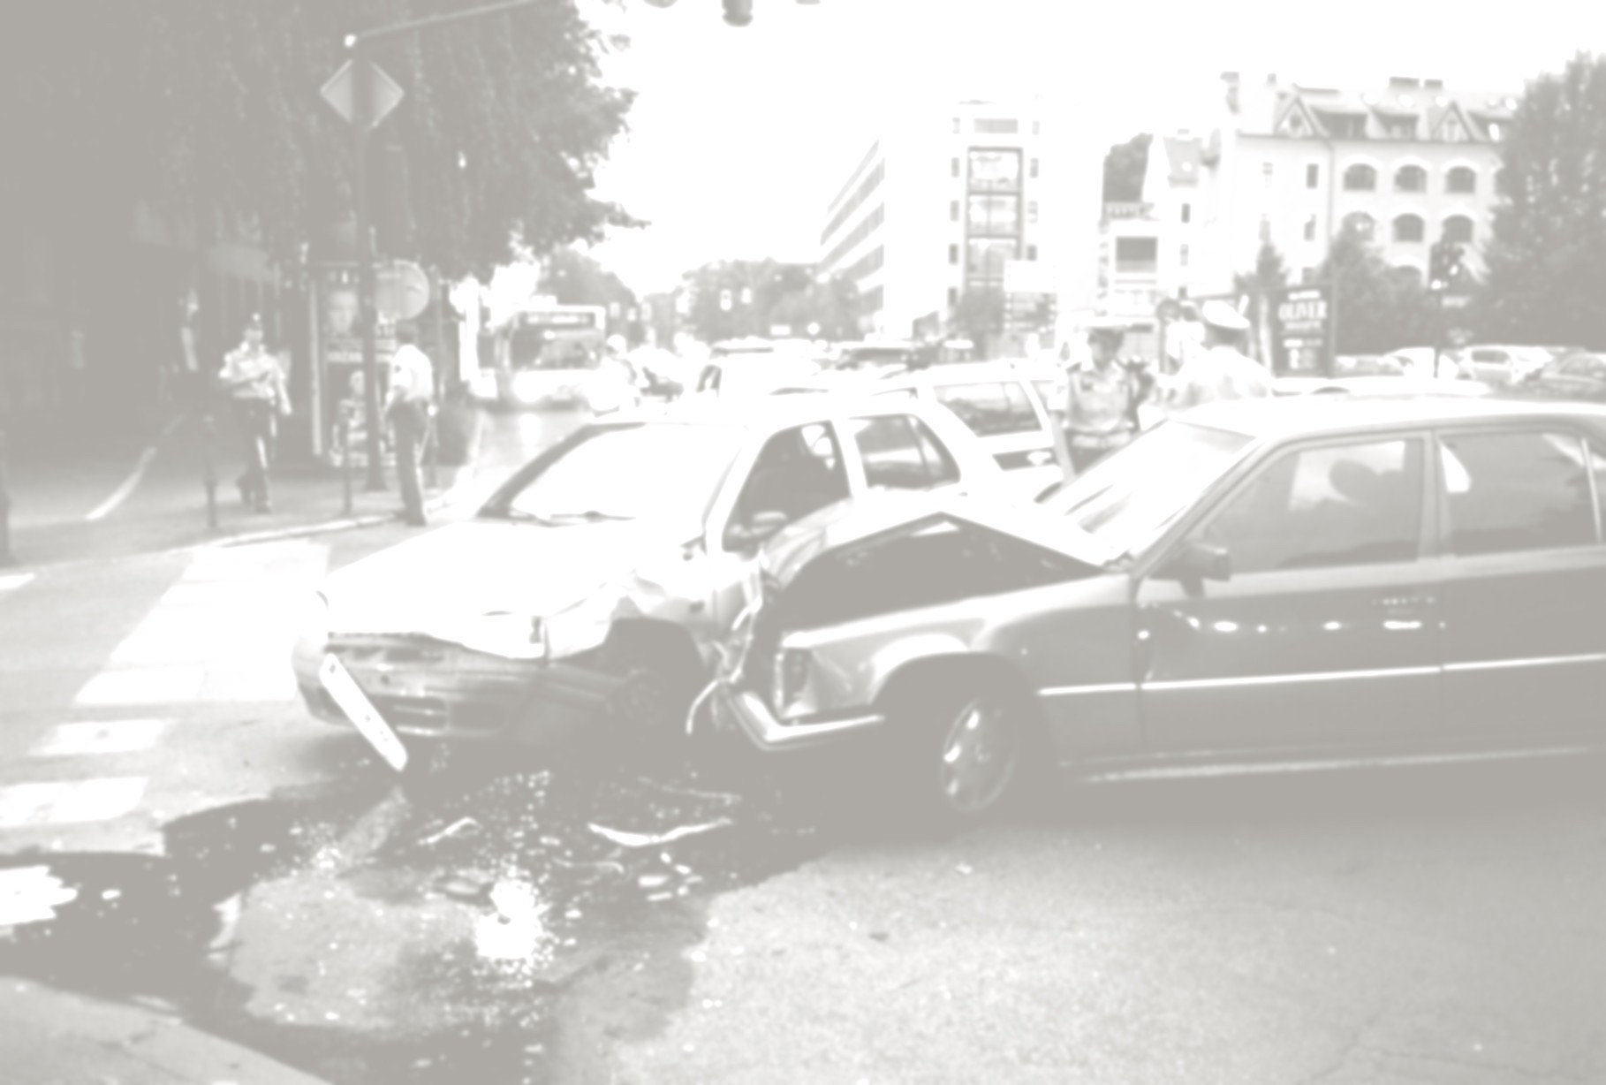
Telematics
Jaewoong Kang

Slide 2
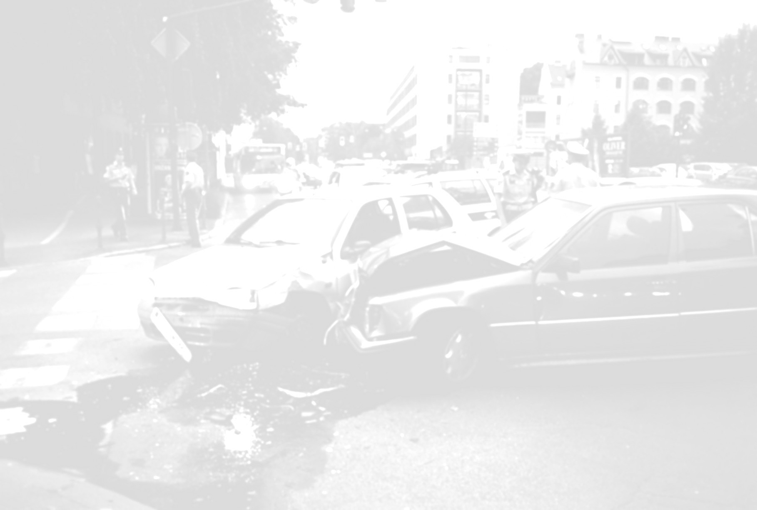
Introduction
Project Purpose: To establish a small computer which can use as many useful devices for car (ex: Navigation, Blackbox)
Main components: Raspberry Pi Vibration Sensor Pi Camera Module Touch Screen GPS USB Receiver

Slide 3
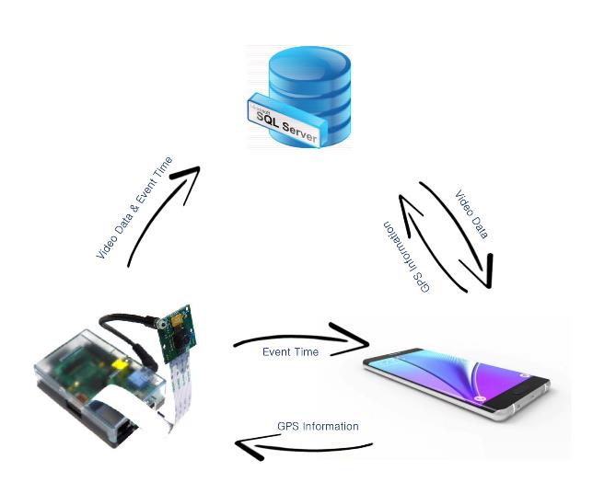
Basic Idea

Slide 4
Functions in Hardware Part
Raspberry Pi records 10 sec short video
If recording has completed, video file is transferred to temporary folder, and start to record new video
If there are already 2 video files in temporary folder, older file is overwritten
If a vibration sensor catches the event signal, Raspberry Pi makes new folder with event time, then copies 2 video files from temporary folder.
When event video completes to record, it is also sent to event time folder
In wifi zone, Raspberry Pi transfers event folders which have been recorded into Server

Slide 5
Functions in Hardware Part
Recording Start
temp: no file
Recording Continuously
temp: video1 video2
Event
Finished recording event
temp: video1 video2
2016-11-20: video1 video2 video3
temp: video1 video2
2016-11-20: video1 video2

Slide 6
Budget
Components | Spent Price | Suggestion Price
Raspberry PI2 | 0 | 51.44 CAD
USB Ethernet Adaptor | 23.99 CAD
PI Camera Module | 21.99 CAD | 12.86 CAD
Touch Screen | 70.99 CAD | 56 CAD
Vibration Sensor | 5 CAD | 4.7 CAD
USB GPS Receiver | 0 | 50.72 CAD
PCB | 0 | 10 CAD
Cases | 11.95 CAD | 0
Total ( with Tax) | 151.33 CAD | 209.86 CAD

Slide 7
Progress and Schedule
Finished Progress
Order all parts
Assembling all components
Testing Basic Functionality of camera and sensor
Delayed Progress
PCB Soldering
Remaining Progress
Making Final version of case for Total devices set (3~ 4weeks)
Complete the python programs with Threading include server and database (8weeks)
Make all program as GUI for touchscreen (2~3days)
Final testing (1 week)

Slide 8
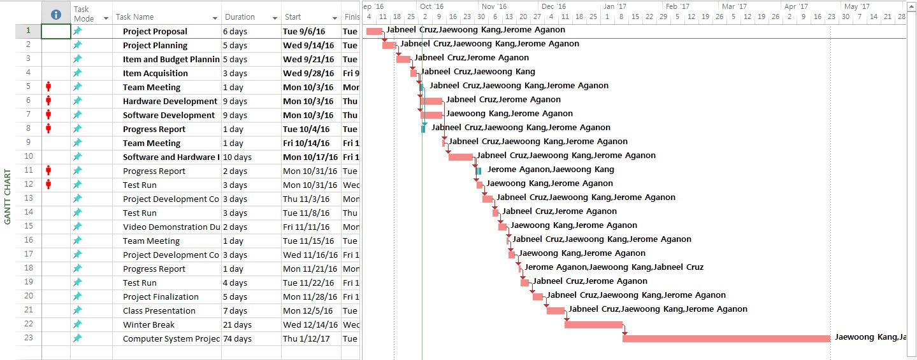
Progress and Schedule
Gantt Chart

Slide 9

Build Video

Slide 10
Required Basic Knowledge
Python To control Pi Camera Module and Sensor
Multi Threading To Run Asynchronous Process
SQL Database For Mobil Access
Basic Electric circuit Simple circuit for LED, Resistors, and Sensor

Slide 11
Thanks

